Slide 1
Early childhood education in the US
Strategy and due diligence for ECE operators and investors
SHIFT Conference
Fall 2026

Slide 2
Our experience
The US market

Slide 3
Cairneagle is a leading independent strategy consultancy with deep specialization in education
INTRODUCTION
About Cairneagle and our education practice
Cairneagle in numbers
Cairneagle, founded in 2001, drawing on experience from LEK and Roland Berger, has grown to be the leading independent specialist education strategy consultancy
Education makes up 100% of our work and our team has conducted 750+ education projects to date
We support decisions that Chief Executives, Boards, and private equity firms make by bringing structure, insight, and judgment to situations of uncertainty, complexity and material financial impact
Approximately 60% of our work is international: we support UK clients to grow internationally and work for multiple overseas clients
We have six highly involved partners, supported by a core team of talented and capable consultants
We have built a strong reputation, based on our rigorous data-driven approach, our analytical audacity and our determination to add value for our clients
Our expertise and continued focus on education has been recognized: we have won the Best Consultants in the Education Sector at the Education Investor Awards eight times since 2015, including in 2026
Advising on education for 25 years
Projects delivered in 40+ countries
600+ education projects in the last seven years
60% of our projects have an international dimension
8 times Education Investor Best Consultants in the Education Sector

Slide 4
We support operators and investors across the education sector with strategy and deal-making, from market entry to due diligence
Our work
Our services: strategy and deal-making support
Strategy example projects
Deal-making example projects
Build new revenue streams and enter new markets
Review your portfolio, business unit or institutional strategy
Design a digital strategy tailored to your business
Screen and diligence acquisitions
Growth Strategy
Market Assessment
Corporate Strategy
Portfolio Review
EdTech Assessment
Product Development Strategy
Acquisition Screening
Commercial Due Diligence
Go-to-market Strategy
Pricing Strategy
Business Planning
Cost Optimization
AI Enablement Strategy
Digital Strategy
Regulatory Due Diligence
Vendor Due Diligence

Slide 5
Cairneagle's education-only focus, bespoke approach, and 360° global perspective make it the natural partner for US clients who demand more than the standard consulting playbook
Why Cairneagle?
02
03
04
05
25 Years.
Proven.
Education,
End-to-End
25 Years.
Proven.
Insight That
Actually Works
Global Lens,
Local Impact
Partners, Not
Just Consultants
25 years proven
Education is all we do
Insight that actually works
Global perspective,
US fluency
Hired once. Trusted forever
Award-winning education consultancy with 25 years of experience navigating an ever-evolving sector — from policy shifts to market disruption
From early childhood through to lifelong learning — B2C, B2B, B2B2C and beyond. We cover the full education landscape, including investors into the sector
The right answer starts with asking the right questions — not opening the right playbook. We bring robust primary research, actionable insights, and a fully integrated team with deep partner involvement
We bring an international perspective to answer your most important US questions — drawing on global benchmarks and cross-market expertise
Clients come back repeatedly — we’ve done 80 projects for one of our clients. It’s because we tune in to their specific situation and deliver consulting that fits them, not an off-the-shelf template

Slide 6





















Our portfolio of work in US education includes a wide range of clients and sectors
Our US experience
Example projects
Selected targets and clients for discussion
We have developed a deep understanding across the US education market:
Multiple CDDs for Tes, including TeachStarter (Australia, UK, US, and international) and The Safeguarding Company (UK, US, and international)
Vendor Commercial Due Diligence for a US Experiential Corporate Training business
CDD of GL Education, an assessment and supplemental content company
CDD of supplemental content platform
US GTM and digital strategy for a K-12 STEM tools provider
c.50 projects for international electronic whiteboard manufacturer, many of which focused on developing and implementing their US growth strategy, including market assessment, distribution, product, and pricing strategy
Multiple international and private school CDDs
Market entry strategy for global international school groups
Greenfield strategy work for a global international school group
Market entry strategy for international ECE chain
M&A screening for international ECE chain
CDDs of ECE groups
Review of US tutoring and corporate training markets
We leverage our global expertise to help US clients internationalize:
10 projects for global, US-based educational publisher, most recently supporting turnaround strategy on Australian K-12 business unit
International higher education strategy for two US-based education publishers
CDD of UK teacher supply business for US PE fund

Slide 7


















Our early childhood education work spans 15 countries across North America, Europe and Asia, giving US clients international benchmarks
Our experience in ece
Overview of Cairneagle’s historical geographic coverage in early childhood education (ECE) projects
North America
Europe
Asia

Slide 8
















We have advised leading ECE operators and investors on over 150 deals and growth projects across North America, Europe, and Asia
Our experience in ece
Example projects
Selected targets, clients and buyers
State - and municipality - level assessments for Busy Bees USA / BrightPath, and commercial due diligence of Learn and Play Montessori in California
Market entry strategy into the US
Evaluation of opportunity for expansion into Canada
CDD of Busy Bees to support Temasek’s minority investment
Vendor commercial due diligence of Storal Learning
Commercial due diligence of Mama Bears’ Bristol settings for Grandir
Vendor commercial due diligence of La Maison Bleue
Commercial due diligence of Kids Planet (2025 and 2021 processes)
Vendor commercial support on ICP Education, prior to Oakley Capital’s acquisition
Vendor commercial due diligence of Family First to support their ownership restructuring
Vendor commercial due diligence of Monkey Puzzle
ECE strategy work and CDD for Dukes Education, including an assessment of its 10 childcare centers
Commercial due diligence of childcare centers for Wishford School Group
Commercial due diligence of KidsFoundation (now Partou)
Market entry strategy into Germany for a top 5 global childcare operator
If you would like to learn more about our credentials, please ask a member of the team

Slide 9
Our experience
The US market

Slide 10
The US center-based ECE market is worth $77bn; c.70% of US centers are for-profit and c.90% of those are single sites or small groups, meaning further consolidation is possible
US market - overview
US center-based ECE market, 2025
Share of centers by provider segment, 2024
$77bn
center-based childcare spend each year, 74% of it paid privately by families; 6x the UK market ($13bn)
c.95k
c.68k
Large groups
1%
Mid-sized
groups
Not for profit
19.9m
children aged 0–5, of whom 30% (5.9m) attend center-based care
Small Groups
(under 20 centers)
& single sites
89%
For profit
c.61k
Single sites and small groups are c.90% of all for-profit childcare centers, creating a significant consolidation opportunity
Total Market
For Profit Market

Slide 11
Cost-of-living pressures are impacting parent affordability, and the expansion of universal free pre-K is drawing families away, all while operating costs keep rising
US market - Trends
Key market trends
Trends | Key takeaways | Cairneagle view on sector impact
Demographics | US 0–5 population down c.1.9m since 2015, estimated to be relatively flat to 2030 | Growth must come from share gains or penetration
Enrollment | c.40% of providers saw softer enrollment in late 2025, universal pre-K drawing children away from private providers | Demand varies significantly depending on location
Staffing | Hiring and retention improved since 2020; wage inflation persists | No longer the main constraint, but rising wages are squeezing margins
Affordability | Costs rising faster than revenue; families resisting fee rises | Balancing quality and affordability is the main challenge
Government funding | Expanded tax benefits for corporates and individuals and school choice funding in states like TX could benefit providers; federal and state subsidies fall short of cost | Policy increasingly impacts providers’ success
Moderate concern
Sentiment key:
High concern
Low concern

Slide 12
We answer the questions that drive growth and deal value in US ECE
US Market - key questions
Questions operators bring us
Questions investors bring us
How can we win in a market that is under duress?
Which US states and metros should we enter next, and in what order?
Should we grow through greenfield sites, acquisitions, or franchising?
How will UPK, TK and subsidy changes affect our enrollment and fees?
Where can we raise fees without losing occupancy?
Is the long-term outlook for ECE still sustainable given recent pressures?
Which platforms make the most sense from a geography, proposition, performance, and value creation perspective?
How exposed is the business to state funding and policy changes, e.g., UPK?
How much consolidation runway is left in this market?
Does the buy-and-build thesis hold at site level?

Slide 13
We have applied our deep early childhood education expertise to evaluate and shape ECE growth strategies across multiple US states
US market - our work
Cairneagle has extensive US experience across major ECE markets, including CA, VA, MD, NC, MA, NY, IL and WA — spanning state-level regulation, metro-level demand, and site-level economics
What we deliver:
    State and metro-level market sizing and segmentation
    Penetration, enrollment, demand drivers, and fee dynamics
    Child-per-place (CPP) heatmaps and competitive intensity
What we deliver:
    Investment case validation (premium positioning, margin outlook, demand resilience)
    Acquisition target assessment & greenfield viability
    Clear strategic recommendations on entry model, pacing, and regions
Market & Demand
Intelligence
Investment & Growth Strategy Support
What we deliver:
    Mapping of local competitors, density, and value propositions
    Mystery shopping and pricing/occupancy benchmarks
    Identification of actionable acquisition targets
Approaches to
US ECE
Work
What we deliver:
    On-the-ground primary research, including large-scale operator and parent surveys
    Expert interviews across policy, operators, and associations
    Direct insight into fee-setting, staffing, and occupancy challenges
Competitive & Operator Landscape Benchmarking
Customer
Insights
What we deliver:
    State preschool/UPK/SPK implications¹
    Voucher schemes, subsidy regimes, and TK expansion impacts²
    Licensing, ratio, and operational feasibility constraints
Regulatory &
Funding
Insight
Geographic Strategy & State Selection
What we deliver:
    Identification of highest-potential states and metros
    Zip-code level affluence, demographics and income analysis
    Screening and prioritization of greenfield vs acquisition entry points

Slide 14

We have evaluated US metro areas across a variety of factors to determine the most attractive markets for childcare to guide future growth
US market - metro screening
Our metro area screening approach
What drives each metro area’s score
Market size
Childcare spend and demand from young families
Household affluence among families with young children
Population size, density, and competitor penetration
All metro areas
Filtered by population size and income
Growth outlook
Young child population growth
Local economic growth
Household income growth
Filtered metro areas
Scored and ranked considering metrics driving
(1) market size (2) growth outlook and
(3) operational/margin considerations
Operational / margin considerations
Fees relative to costs of staff and property
State regulation and workforce requirements
Business environment and proximity to other metros
Top metro areas
Profiled based on the above with key strengths & areas worth further exploring identified
Ask us at SHIFT for our view on the most attractive US metros for your strategy

Slide 15
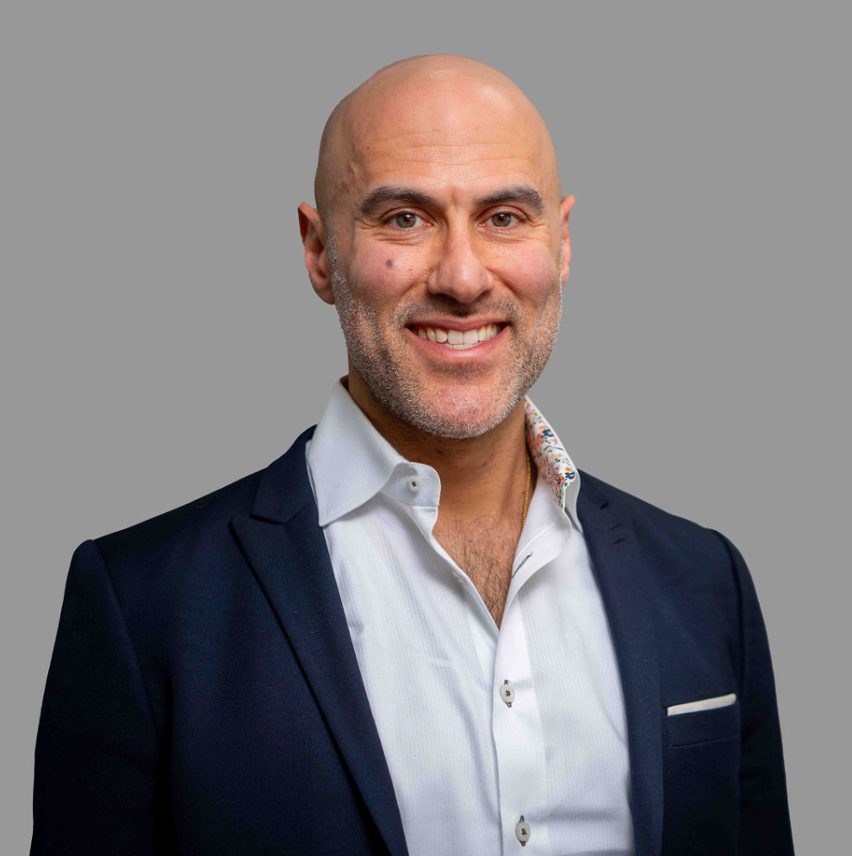

We have a specialist team focusing on the US and ECE
Cairneagle Credentials
Contact a member of the team to discuss ECE work in your region
Arun Kanwar
Partner - Global ECE Lead
Peter Friedman
Principal - US Lead
HMC Board Member
arun.kanwar@cairneagle.com
peter.friedman@cairneagle.com
+1 646 902 5587
Ewan Robertson
Principal - ECE Lead
James Winship
Manager - ECE Lead
ewan.robertson@cairneagle.com
james.winship@cairneagle.com

